Slide 1


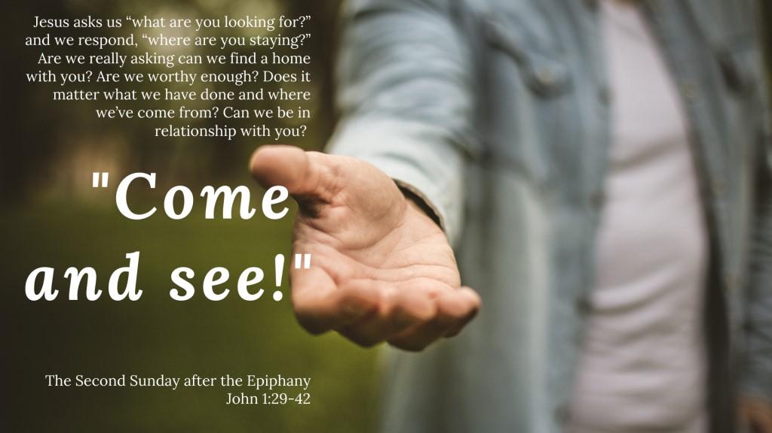
Kogarah Uniting Church
Welcome
18 January 2026
Second Sunday after the Epiphany

Slide 2
Welcome & Greeting (欢迎与问候)
The grace of the Lord Jesus Christ
and the love of God
and the communion of the Holy Spirit
be with you all.
And also with you.

Slide 3

Acknowledgement of Country
(致敬原住民土地)
We acknowledge that this land is God’s land, and God’s Spirit dwells here. We pay our respects to the elders past, present and emerging of the Biddegal people of the Eora nation, who have cared for this land in time beyond our dreaming. This land on which we live and move was and always will be Aboriginal Land.

Slide 4
KUC Vision Statements (教会愿景宣言)
We are a congregation
who welcome people of all cultures and lifestyles,
who create a safe place for the community
and who share the journey of life and faith.

Slide 5
Call to Worship (敬拜呼召)

Slide 6
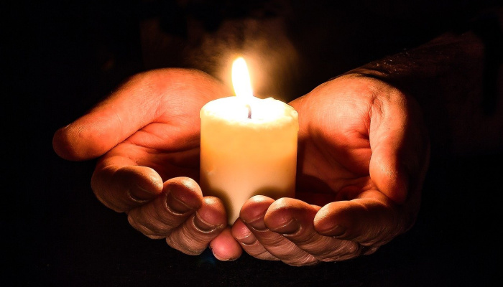
Lighting the Christ Candle (点燃基督之烛)
God is here
God is always here
God is with us
God is always with us

Slide 7
Will you come and follow me if I but call your name?
Will you go where you don’t know and never be the same?
Will you let my love be shown, will you let my name be known,
will you let my life be grown in you and you in me?

Slide 8
Will you leave yourself behind if I but call your name?
Will you care for cruel and kind and never be the same?
Will you risk the hostile stare should your life attract or scare?
Will you let me answer prayer in you and you in me?

Slide 9
Will you let the blinded see if I but call your name?
Will you set the prisoners free and never be the same?
Will you kiss the leper clean, and do such as this unseen,
and admit to what I mean in you and you in me?

Slide 10
Will you love the ‘you’ you hide if I but call your name?
Will you quell the fear inside and never be the same?
Will you use the faith you’ve found to reshape the world around
through my sight and touch and sound in you and you in me?

Slide 11
Lord, your summons echoes true when you but call my name.
Let me turn and follow you and never be the same.
In your company I’ll go where your love and footsteps show.
Thus I’ll move and live and grow in you and you in me.
© 1987 The Iona Community
Reproduced under Copyright Licences:
ONE LICENSE A-604712; CCLI #45150

Slide 12
Opening Prayer (开启祷告)

Slide 13
I was there to hear your borning cry,
I’ll be there when you are old.
I rejoiced the day you were baptised to see your life unfold.
I was there when you were but a child
with a faith to suit you well;
in a blaze of light you wandered off to find where demons dwell.

Slide 14
When you heard the wonder of the Word
I was there to cheer you on.
You were raised to praise the living Lord to whom you now belong.
If you find someone to share your time,
and you join your hearts as one,
I’ll be there to make your verses rhyme from dusk til rising sun.

Slide 15
In the middle ages of your life,
not to old, no longer young,
I’ll be there to guide you through the night,
complete what I’ve begun.
When the evening gently closes in
and you shut your weary eyes,
I’ll be there as I have always been with just one more surprise.

Slide 16
I was there to hear your borning cry,
I’ll be there when you are old.
I rejoiced the day you were baptised to see your life unfold.
© 1985 John Ylvisaker
Reproduced under Copyright Licences:
ONE LICENSE A-604712; CCLI #45150

Slide 17
Prayer of Confession (忏悔祷告)

Slide 18

Declaration of Forgiveness (赦罪宣告)

Slide 19
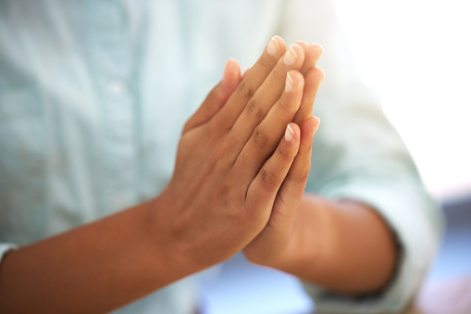
Peace (主内平安)
The peace of the Lord be
always with you.
And also with you.

Slide 20
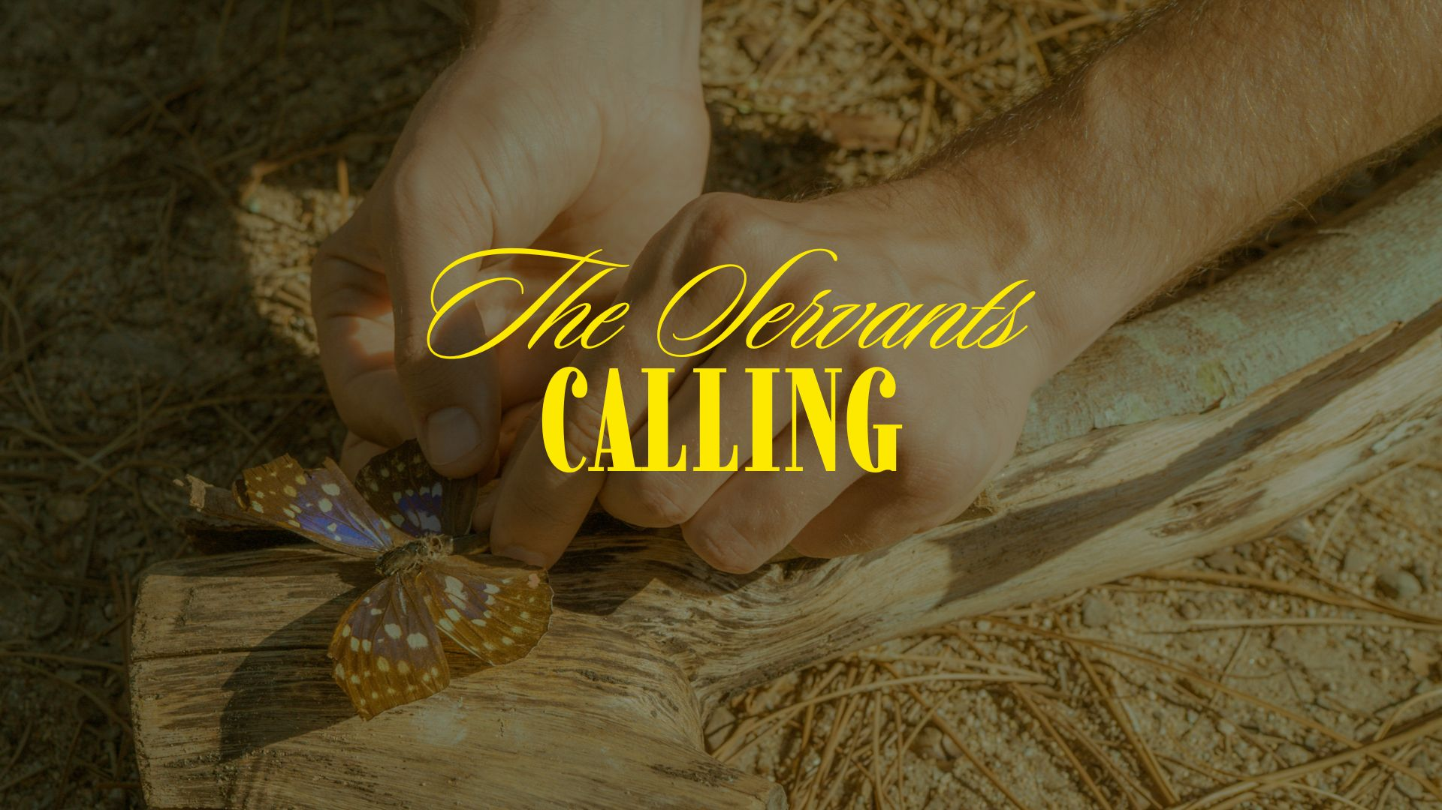
ISAIAH 49:1-7

Slide 21
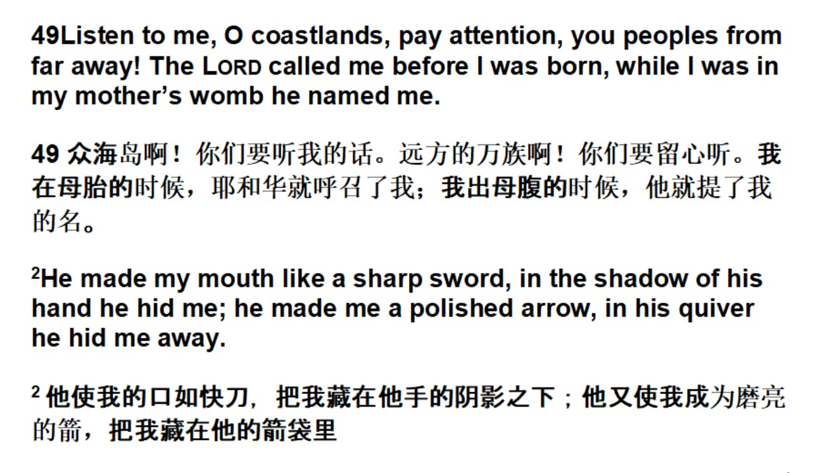

Slide 22
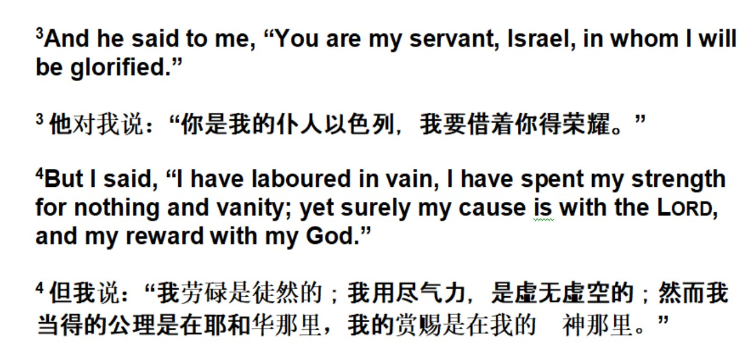

Slide 23
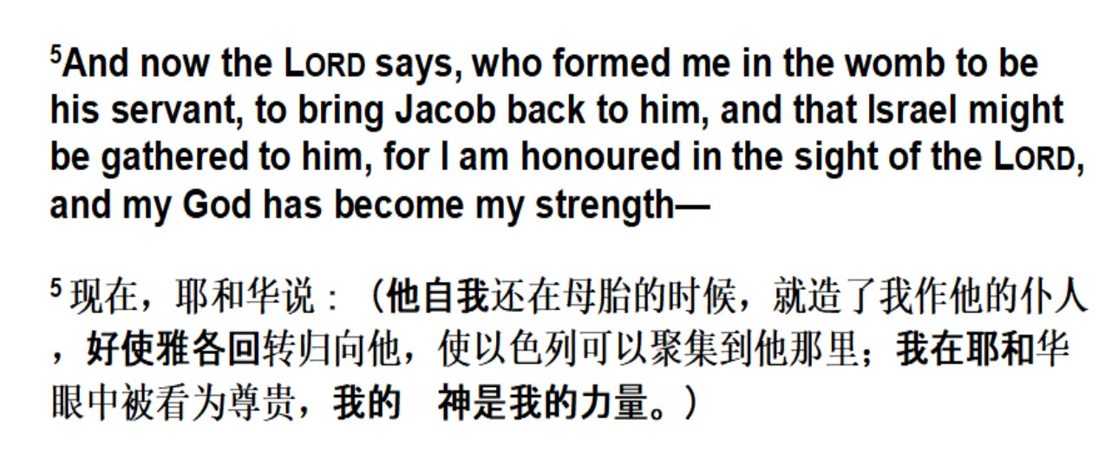

Slide 24
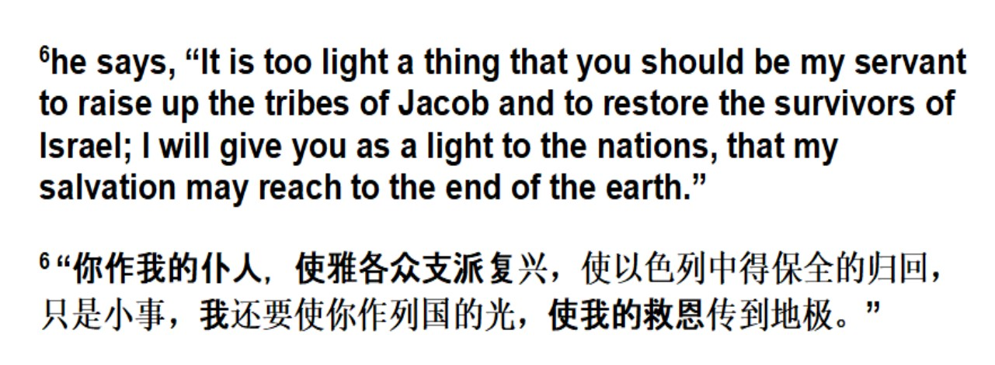

Slide 25
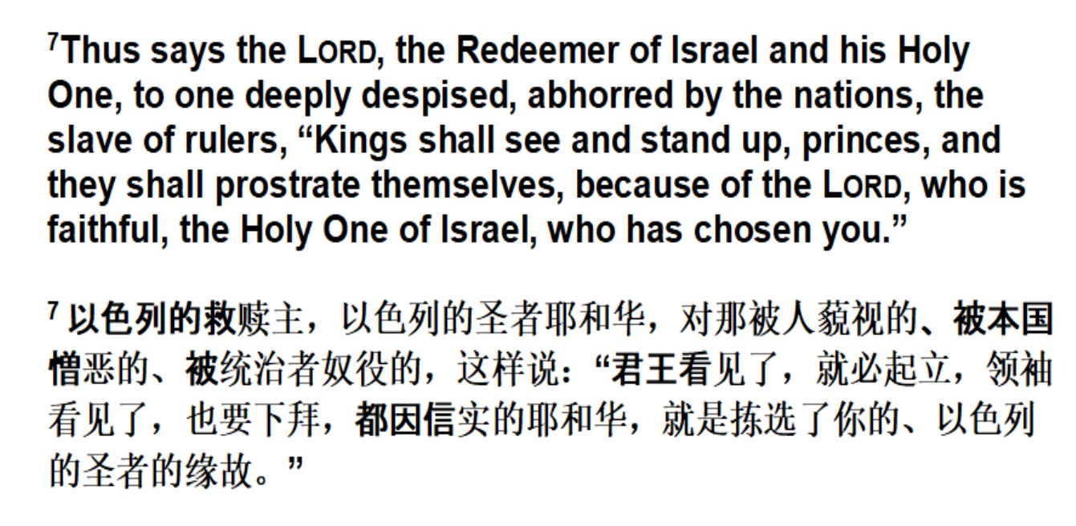

Slide 26
JOHN 1:29-42

Slide 27
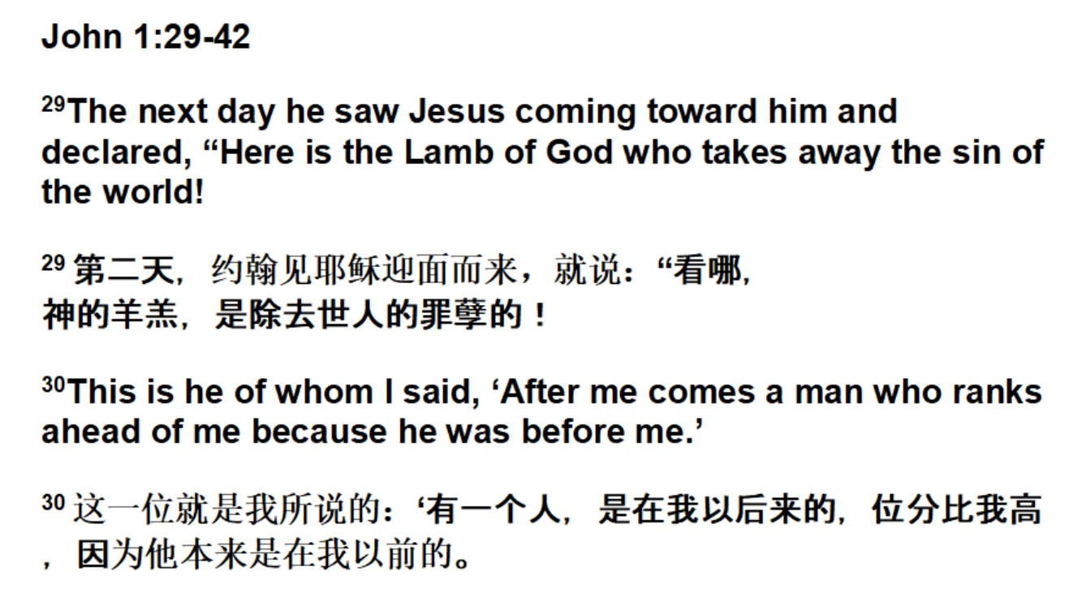

Slide 28
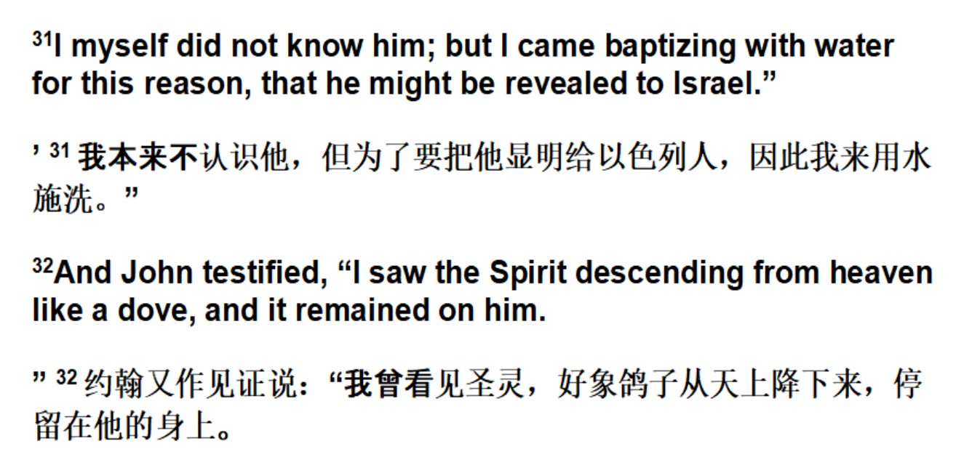

Slide 29
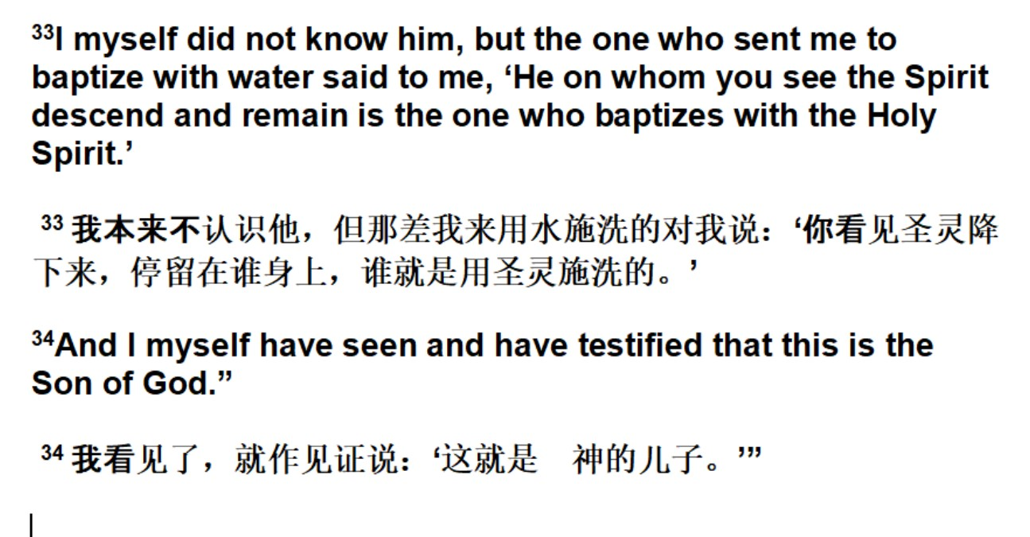

Slide 30
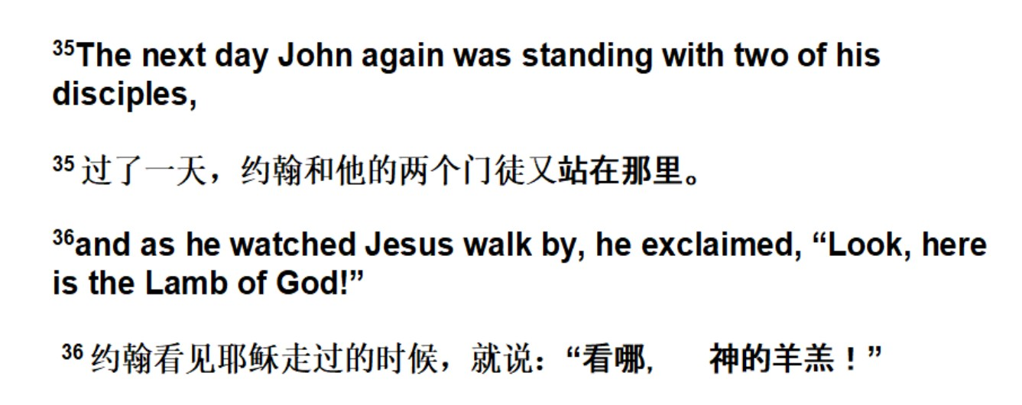

Slide 31
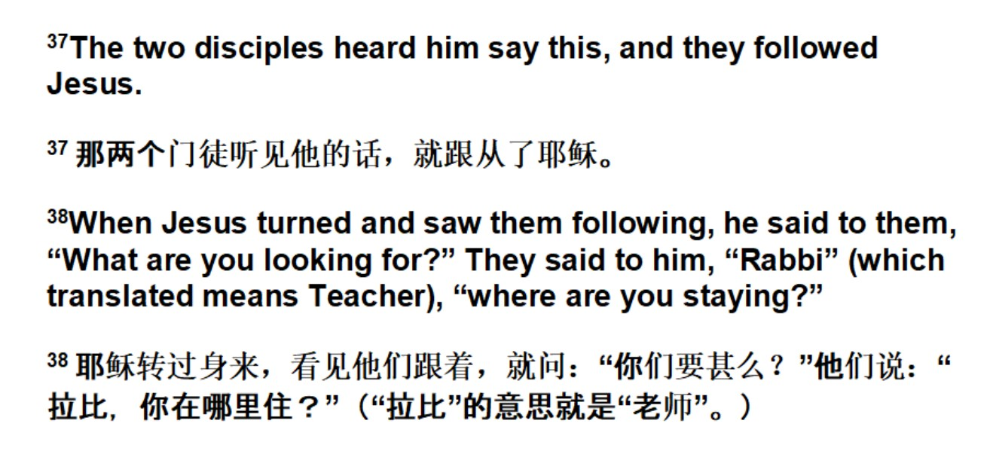

Slide 32
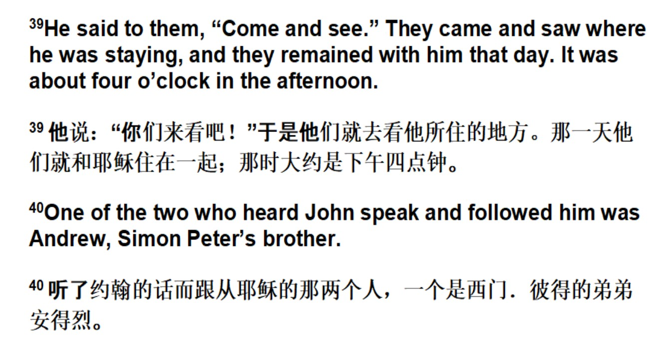

Slide 33
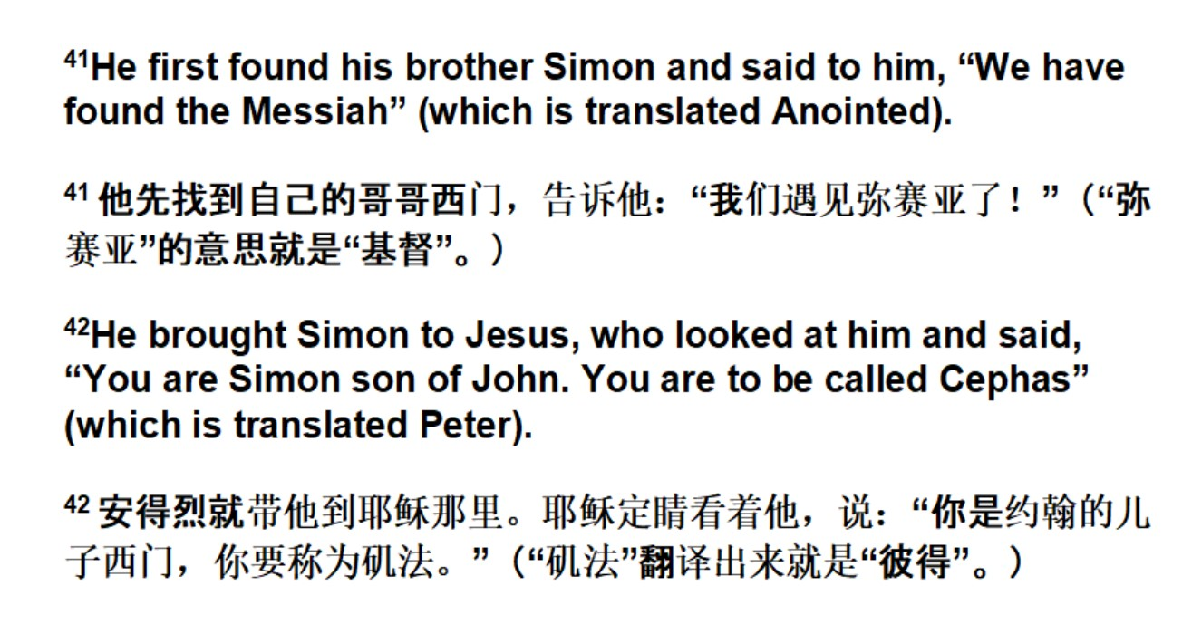

Slide 34
O God, you search me and you know me.
All my thoughts lie open to your gaze.
When I walk or lie down, you are before me:
ever the maker and keeper of my days.

Slide 35
You know my resting and my rising.
You discern my purpose from afar,
and with love everlasting you besiege me:
in ev’ry moment of life or death, you are.

Slide 36
Before a word is on my tongue, Lord,
you have known its meaning through and through.
You are with me beyond my understanding:
God of my present, my past and future, too.

Slide 37
Although your Spirit is upon me,
still I search for shelter from your light.
There is nowhere on earth I can escape you:
even the darkness is radiant in your sight.

Slide 38
For you created me and shaped me,
gave me life within my mother’s womb.
For the wonder of who I am, I praise you:
safe in your hands, all creation is made new.
Words based on Psalm 139
© 1992, Bernadette Farrell; published by OCP Publications
Reproduced under Copyright Licences:
ONE LICENSE A-604712; CCLI #45150

Slide 39

Reflection (信息分享)

Slide 40
I am the light of the world!
You people come and follow me!
If you follow and love, you'll learn the mystery
of what you were meant to do and be.

Slide 41
When the song of the angels is stilled,
when the star in the sky is gone,
when the kings and the shepherds have found their way home,
the work of Christmas is begun!
I am the light of the world!
You people come and follow me!
If you follow and love, you'll learn the mystery
of what you were meant to do and be.

Slide 42
To find the lost and lonely one,
to heal that broken soul with love,
to feed the hungry children with warmth and good food,
to feel the earth below the sky above!
I am the light of the world!
You people come and follow me!
If you follow and love, you'll learn the mystery
of what you were meant to do and be.

Slide 43
To free the prisoner from his chains,
to make the powerful care,
to rebuild the nations with strength and goodwill,
to call a man your brother everywhere.
I am the light of the world!
You people come and follow me!
If you follow and love, you'll learn the mystery
of what you were meant to do and be.

Slide 44
To bring hope to every task you do,
to dance at a baby's new birth,
to make music in an old man's heart,
and sing to the colours of the earth!
I am the light of the world!
You people come and follow me!
If you follow and love, you'll learn the mystery
of what you were meant to do and be.
© text, Howard Thurman, Jim Strathdee (from John 8:12); music, Jim Strathdee
Reproduced under Copyright Licences:
ONE LICENSE A-604712; CCLI #45150

Slide 45

Offering (奉献)

Slide 46
Announcements (家讯报告)

Slide 47

Prayers for Others
(为世界祈祷)

Slide 48
The Lord’s Prayer (主祷文)
Our Father in heaven, hallowed be your name,
your kingdom come,
your will be done on earth as in heaven.
Give us today our daily bread.
Forgive us our sins as we forgive those who sin against us.
Save us in the time of trial and deliver us from evil.
For the kingdom, the power,
and the glory are yours now and for ever. Amen.

Slide 49
Come with me, come wander, come welcome the world
where strangers might smile or where stones may be hurled.
Come leave what you cling to, lay down what you clutch,
and find, with hands empty, that hearts can hold much.
Sing hey for the carpenter leaving his tools!
Sing hey for the Pharisees leaving their rules!
Sing hey for the fishermen leaving their nets!
Sing hey for the people who leave their regrets!

Slide 50
Come walk in my company, come sleep by my side,
come savour a lifestyle with nothing to hide.
Come sit at my table and eat with my friends,
discovering that love which the world never ends.
Sing hey for the carpenter leaving his tools!
Sing hey for the Pharisees leaving their rules!
Sing hey for the fishermen leaving their nets!
Sing hey for the people who leave their regrets!

Slide 51
Come share in my laughter, come close to my fears,
come find yourself washed with the kiss of my tears.
Come stand close at hand while I suffer and die,
and find in three days how I never will lie.
Sing hey for the carpenter leaving his tools!
Sing hey for the Pharisees leaving their rules!
Sing hey for the fishermen leaving their nets!
Sing hey for the people who leave their regrets!

Slide 52
Come leave your possessions, come share out your treasure,
come give and receive without method or measure.
Come loose every bond that’s resisting the Spirit,
enabling the earth to be yours to inherit.
Sing hey for the carpenter leaving his tools!
Sing hey for the Pharisees leaving their rules!
Sing hey for the fishermen leaving their nets!
Sing hey for the people who leave their regrets!
© 1987 The Iona Community
Reproduced under Copyright Licences:
ONE LICENSE A-604712; CCLI #45150

Slide 53
Blessing (祝福)

Slide 54
Sent by the Lord am I; my hands are ready now
to make the earth the place in which the kingdom comes.
Sent by the Lord am I; my hands are ready now
to make the earth the place in which the kingdom comes.
The angels cannot change a world of hurt and pain
into a world of love, of justice and of peace.
The task is mine to do, to set it really free.
O help me to obey, help me to do your will.
© 1988, 1996, Abingdon Press; text Jorge Maldonodo
Reproduced under Copyright Licences: ONE LICENSE A-604712; CCLI #45150

Slide 55
"Permission to reprint, podcast, and / or stream the music in this service obtained from ONE LICENSE with license #A-604712.
All rights reserved.”

